Slide 1
Introduction to front end engineering

Slide 2
Agenda
Introduction
Front End Experience
Front End Engineering
Example Project
Vue.js
JavaScript & TypeScript
Frameworks
Component Design
Vue.js
LET’S BUILD AN APP

Slide 3
FRONT END EXPERIENCE

Slide 4
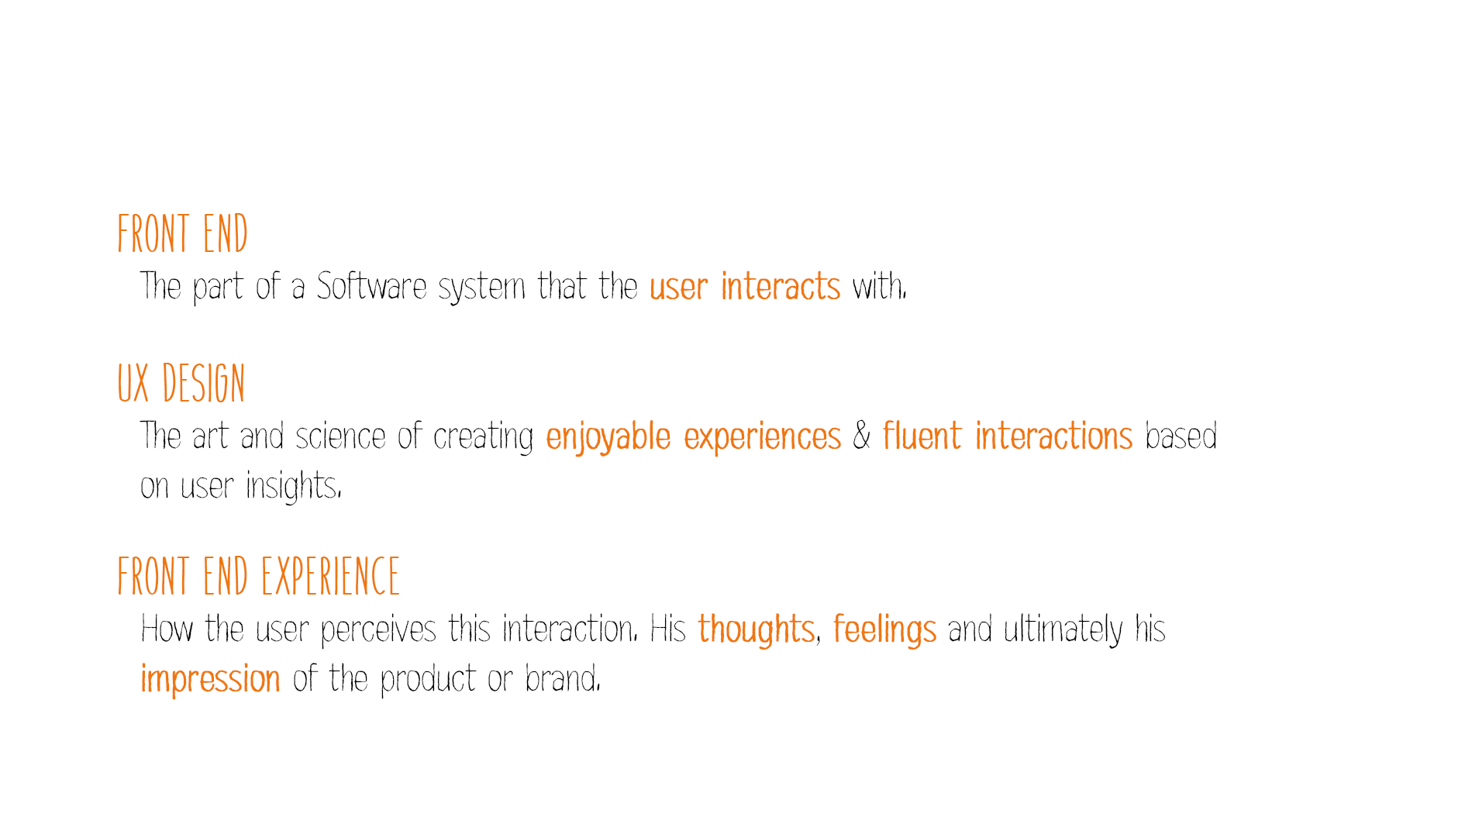
Front End Experience
Notes:
Je front end, als belangrijkste touchpoint met je klanten, moet gewoon GOED zijn. Onze insteek is dat we breder kijken dan de typische requirements (‘een functionele interface die er liefst ook goed uit ziet’), maar willen focussen op de totale ERVARING van een gebruiker. Het is uiteindelijk die ervaring die je gebruikers gaat binden aan je product of brand. We mikken niet alleen op een ‘usable’ product, maar gaan verder: een ‘pleasurable’ en zelfs een ‘desirable’ product.

Slide 5
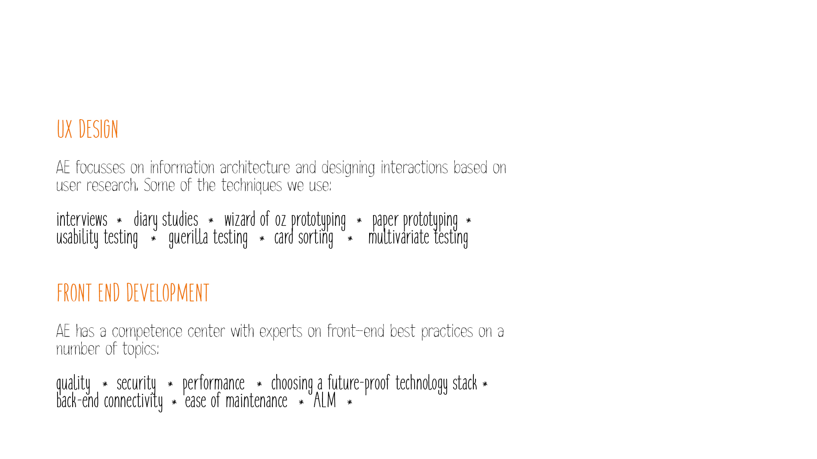
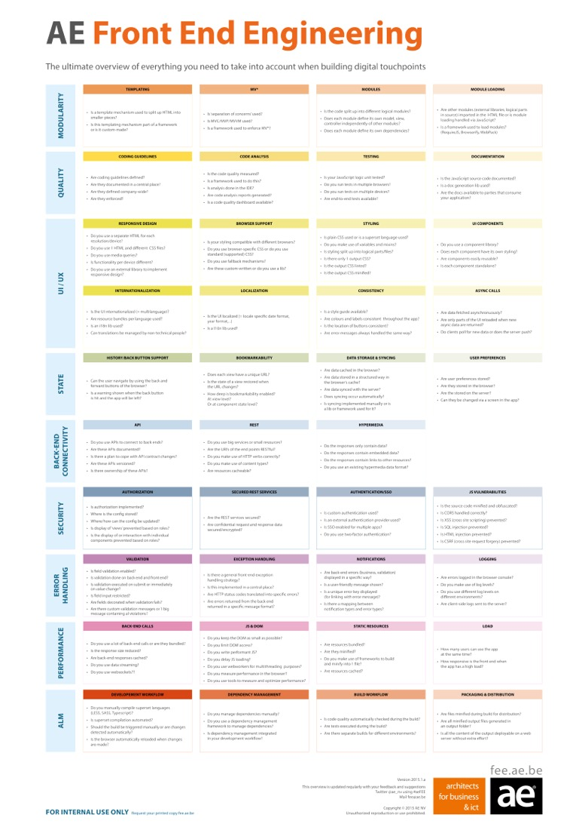
Front End Experience Approach
Notes:
AE heeft op deze beide vlakken de expertise in huis
Enerzijds is er het UX aspect. Hoe moet een front end eruit zien om de totale ervaring van een gebruiker zo goed mogelijk te maken? Je doet dit door oa een information architecture op te zetten. Het is belangrijk om je front-end design af te checken met je gebruikers, en liefst zo snel mogelijk. Hoe sneller je deze stap opneemt in je proces, hoe minder rework later. Enkele technieken om gebruikers ervaring te capteren zijn opgelijst.
Anderzijds is er het technisch aspect. Eens je een fantastische UX hebt ontworpen, heb je natuurlijk technologie nodig die dat kan realiseren. AE beschikt over kennis en ervaring met de meest recente technieken om een compelling UX te realiseren. Maar we verliezen daarbij het kostenplaatje nooit uit het oog. Dat wil zeggen dat we expertise hebben in kwaliteit en ALM (om rework en regressie te vermijden), niet zomaar op de nieuwste hype springen maar een future-proof stack kiezen, en inzetten op het minimaliseren van maintenance (denk bv. aan het gebruik van hybrid frameworks: 1 code base voor alle mobiele platformen).

Slide 6
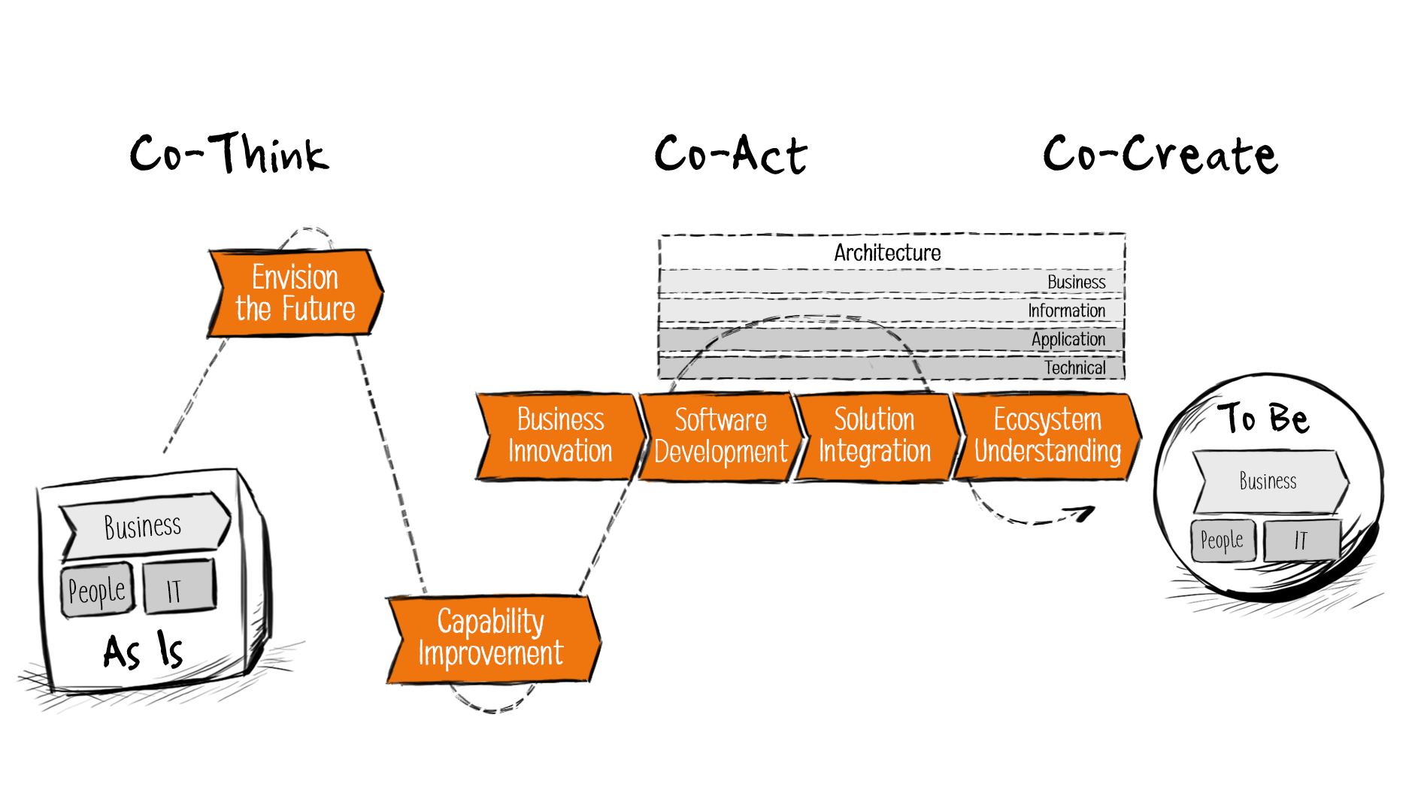

Team composition and reinforcement
Assessment, Coaching, Training
Agile Mixed Teams of Business, UX and Technical Experts
End to end delivery
User Story Workshops, User Research UX & UI design
Frequent Demos, Capture & Process User Feedback, Go 2 Market

Slide 7
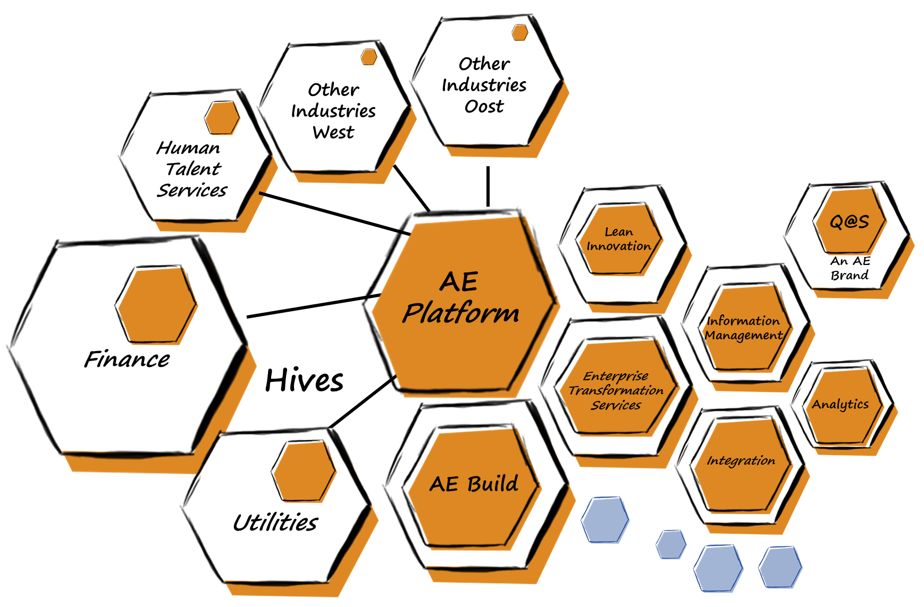

Slide 8
PM
Human interaction
FEE
UX
Technisch
Business / Functioneel
Java
.NET

Slide 9
FEE Core Team
SOPHIE TRAEN
FEE LEAD & COMMUNITY MANAGER
GLENN DEJAEGER
KENNIS & INNOVATIE COÖRDINATOR
JORIS HIAS
ALL THINGS UX

Slide 10





How to Connect
#FEE
AefeeSOLUTION@ae.be
AE build - hive
Front end engineering
#FEE
#FRONT-eND-architecture

Slide 11
FRONT END ENGINEERING

Slide 12

Front End Engineering Domains
Web
Mobile
Wearables
Iot
vr/Ar/Mr
Notes:
Multi platform
Android / iOS
Multiple versions of Android and iOS
Multi device
Multiple vendors / OS skin + tools
Smartphone, tablet, phablet
Multiple sizes
Usability
interactie tussen gebruiker en front end
muis? touch?
waar welke data weergeven?
hoe data weergeven?
welke componenten?
lay out, navigatie
Accessibility
alternatieve tekst op afbeeldingen
aria-labels
groter font

Slide 13
Technical aspects of FEE
MODULARITY
UI/UX
QUALITY
STATE
ALM
SECURITY
PERFORMANCE
BACK END CONNECTIVITY
ERROR HANDLING
Notes:
Modularity = ease of maintenance, resuability of code, refactorability, …
Quality = code quality maar ook application quality => automated testing, user testing, debugging, …
UI/UX = usability, navigatie, huisstijl (kleuren, fonts, …), responsiveness, (browser) compatibility
State = user preferences bijhouden, bookmarkability
BE connectivity = API design, API consumption, API call caching
Security = authentication, XSS, CSRF, CSP
Error handling =
form validation, how to display errors, when to validate,
back end validation: how to display and handle business exceptions, offline, server error, failure recovery
Performance = time to display, time to interactive, UI smoothness, amount of data, resource caching
ALM = set up to serve locally, build, build for prod, run code quality checks + tests in CI, build via CI, deploy via CI
Choosing future proof technology is very important => all these requirements need to be kept in mind
=> Overlap met andere domeinen zoals UX/CX, QA, TA, Security, Integration

Slide 14

























































Front End Technologies

Slide 15

Front End Architecture
UTILITIES
QA LINTING TOOLS + TEST RUNNERS & LIBS
UI UI LIBS / FRAMEWORKS + COMPONENTS
DEPENDENCY MANAGEMENT DEPENDENCY MANAGERS + MODULE LOADERS
FOUNDATION
CORE LANGUAGES + FRAMEWORK OR COMBINATION OF LIBS

Slide 16
Front End Architecture
CODING GUIDELINES
BEST PRACTICES
PROJECT STRUCTURE
MODULAR ARCHITECTURE
ALM SETUP
Notes:
Coding guidelines
How to structure your code
Casing, file names, semicolons, curly braces, small functions, descriptive names
Best practices
Best practices for coding, performance, testing,
How to write maintainable code
Project structure
Separate project for front end + separate repo as well
LIFT:
Locate: make locating your code intuitive, simple and fast
Identify: when looking at file you should instantly know what it contains and represents
Flat: keep a flat folder structure as long as possible
T-DRY: try to stick to DRY, don’t go nuts and sacrifice readability
Modular architecture
Use (Angular) feature modules over technical modules
Make self containing modules (= own routing config, responsible for own dependencies, exports, …)
If parts of app are reused by other components, use a shared module
Reusable code by multiple projects: consider creating 1 or more NPM modules
ALM setup
Define how to fetch and use dependencies, do static code analysis, code compilation, unit and integration testing, build, deployment
Plug this setup in the CI => specific config for front end

Slide 17
EXAMPLE PROJECT

Slide 18
Demo

Slide 19
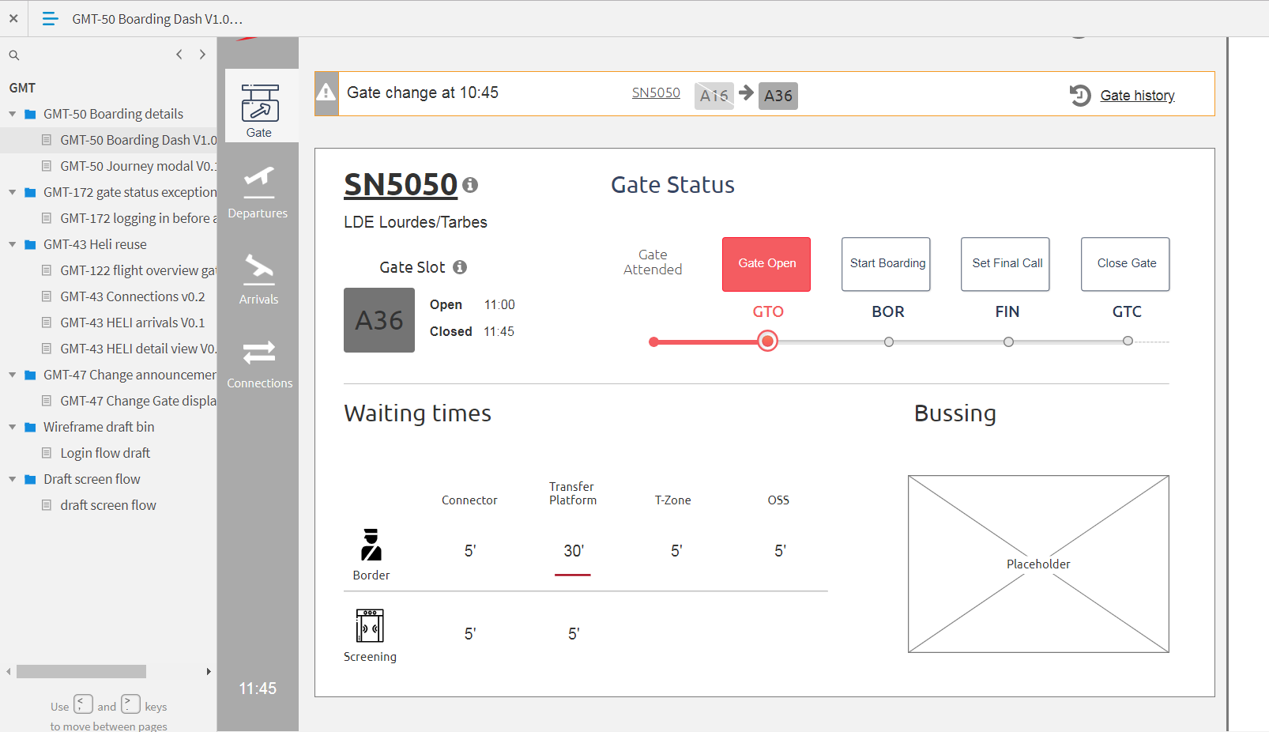
Mockups

Slide 20
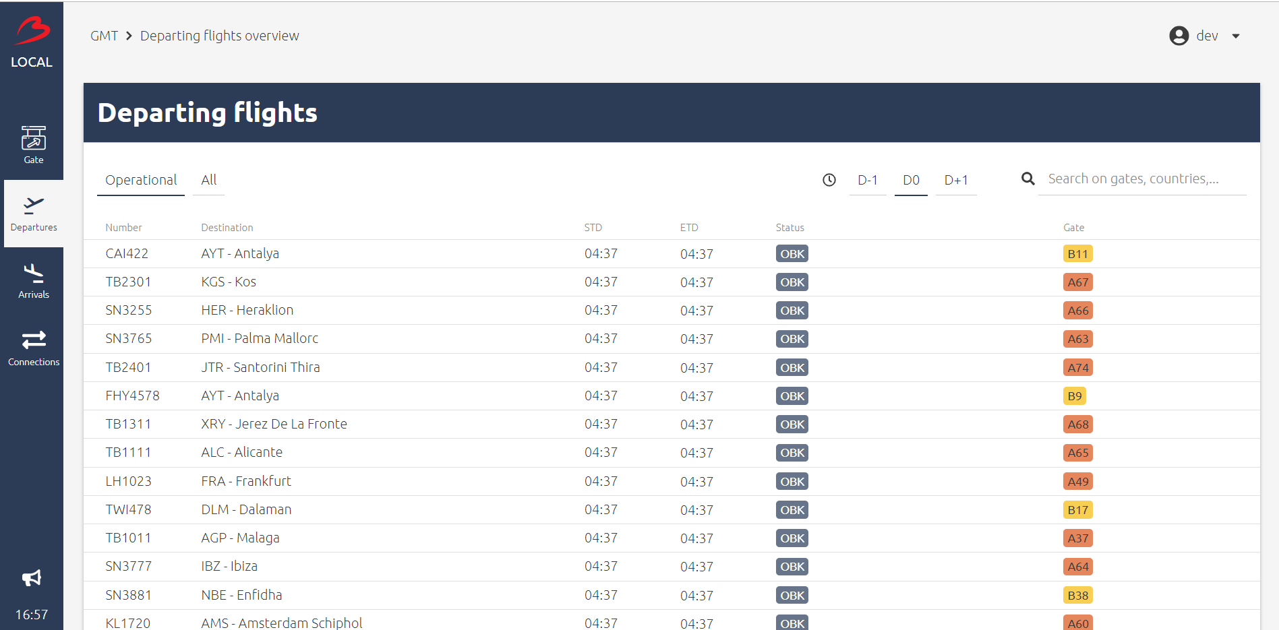
Implementation

Slide 21






Stroomlijnen van de communicatie
Ziekenhuistechnieken in de thuiszorg
Monitoring van de patiënt
Opleiding van leden van het zorgteam
Notes:
Front end engineering = building the part of the software system the user interacts with
A solid front end architecture is mandatory
The front end world is big and evolves at a fast pace
There’s no such thing as ‘a front end engineer’ or ‘a front end engineering project’
Touch points with different domains CX, UX, QA, TA, Security, Integration, Analytics

Slide 22
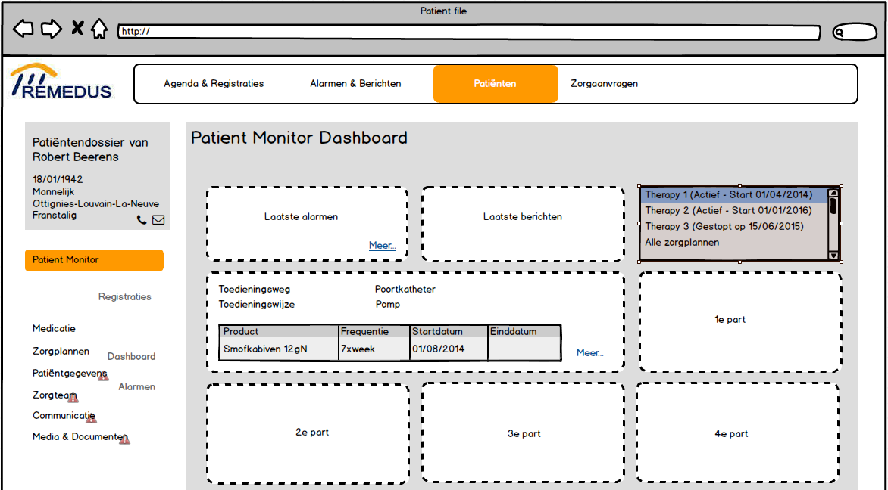

Slide 23
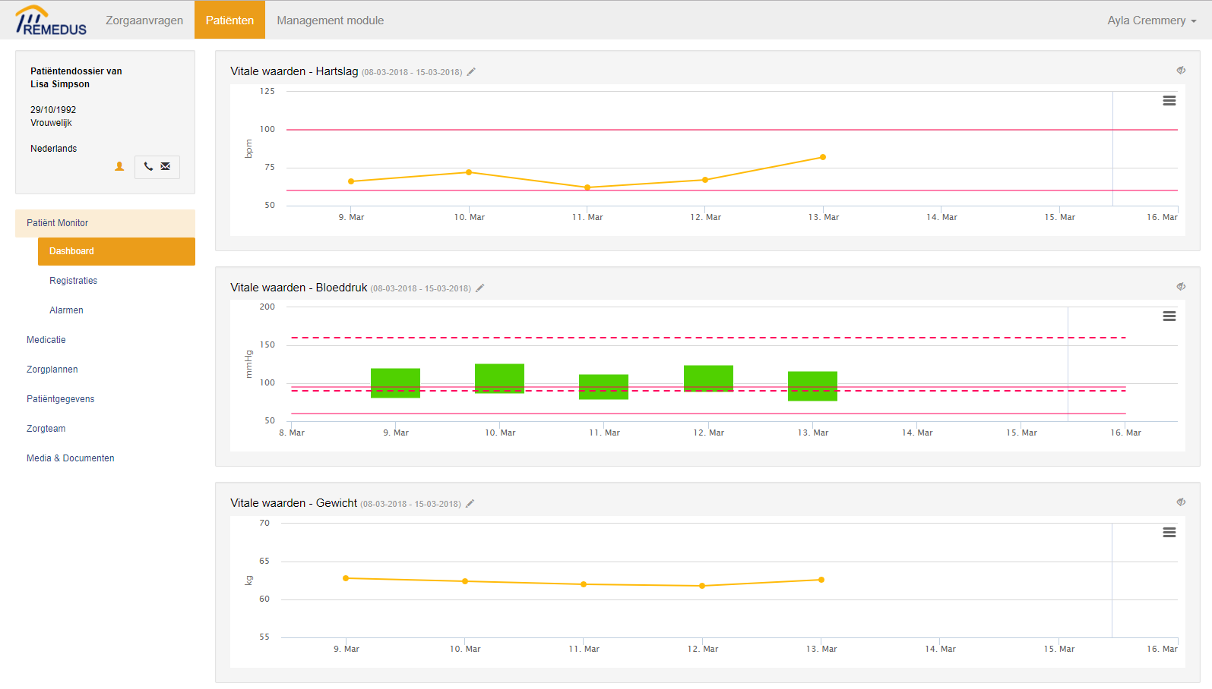

Slide 24
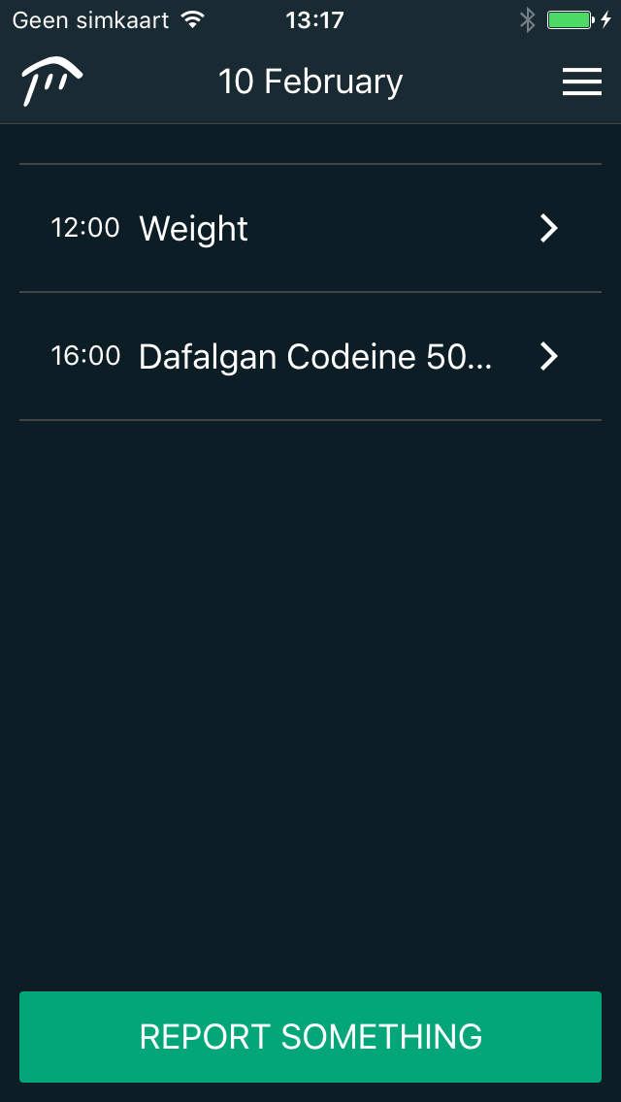
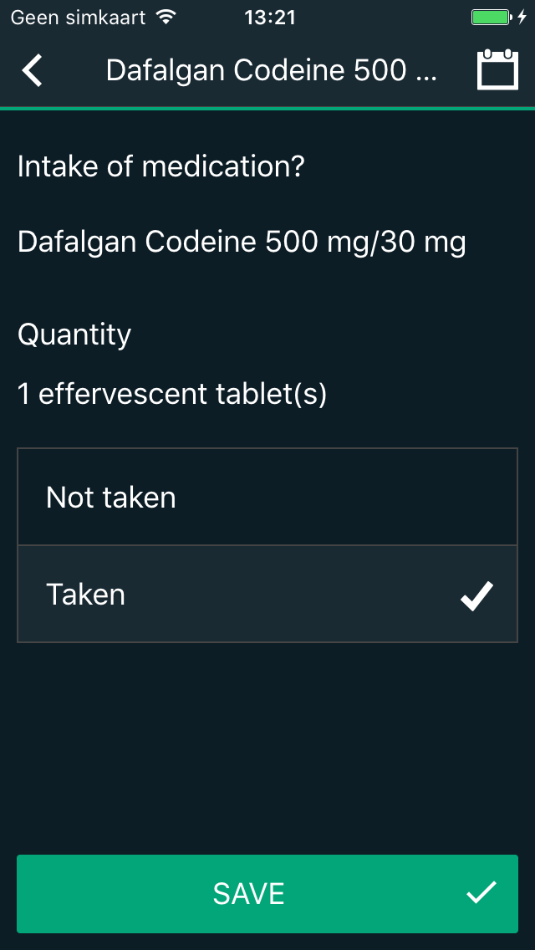
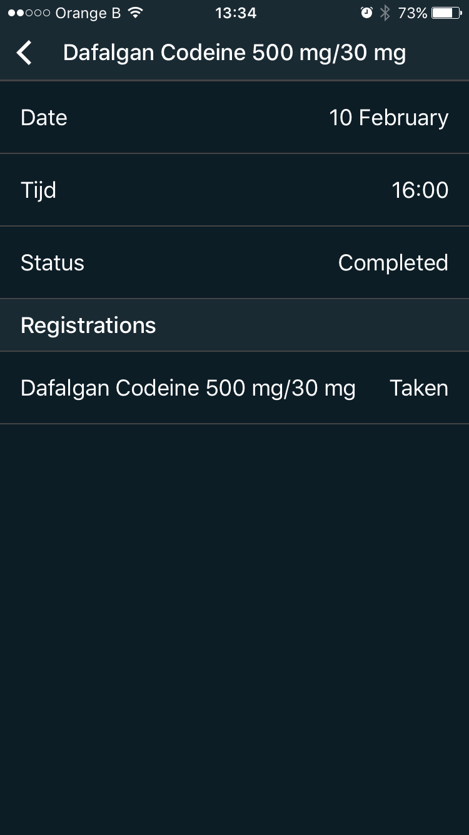

Slide 25

Front End Architecture
UTILITIES
QA LINTING TOOLS + TEST RUNNERS & LIBS
UI UI LIBS / FRAMEWORKS + COMPONENTS
DEPENDENCY MANAGEMENT DEPENDENCY MANAGERS + MODULE LOADERS
FOUNDATION
CORE LANGUAGES + FRAMEWORK OR COMBINATION OF LIBS

Slide 26
JavaScript & TypeScript

Slide 27
JavaScript is the language of the web.
It is built into every modern web browser and is thus available on almost every device.

Slide 28

JavaScript - history
1996
Microsoft introduced Jscript into IE3
2000
Introduction of AJAX
1997
ECMAScript standard was defined
2003
Implementation of ECMAScript 4 was stopped
1995
Mocha was introduced into Netscape Communicator to make the web more dynamic
1999
ECMAScript 3 was released and was supported by major browsers & the baseline target for many libs
1995
2000
https://auth0.com/blog/a-brief-history-of-javascript/
Notes:
1995
Mocha was added to Netscape Communicator, the first popular browser, to make the web more dynamic.
It added animations, interaction and other forms of small automation.
Mocha = a small scripting language that can interact with the DOM. It was not oriented to big-shot developers and people with experience in the software engineering side of things. It targeted designers and scripters instead.
Java, born as Oak, was on the rise. Java applets were announced. But it was too big, too enterprisy to target designers and scripters. Mocha was meant to be the companion for Java. Analogous to C/C++ and Visual Basic on Windows. It was renamed to LiveScript and then to JavaScript (after a deal with Sun) and integrated into Netscape communicator
The object model and functional features of JavaScript, as we know it today, were already present in the first version.
1996
Microsoft answered the introduction of JavaScript with their own version of the scripting language: Jscript. They renamed it to avoid trademark issues
JScript had a different implementation, in particular with regards to DOM functions
1997
ECMA, an industry association formed in 1961, concerned solely with standardization of information and communications systems
For trademark reasons, the name JavaScript couldn’t be used. So they named the standard of JavaScript ECMAScript
Today, JavaScript is just the commercial name for ECMAScript
1999
ES 3, supported by many browsers + baseline target for many browsers was released
It contained the first big changes to the language
Exceptions + try catch block
Regex
Do-while
In and instanceof
Much better error handling
More built in functions for strings and arrays
Formatting for numeric output
2000
AJAX was introduced in the years of ES3
It was not a standard. MS implemented certain extensions to JS for IE5, such as XMLHttpRequest (in the form of an ActiveX control)
Async HTTP requests could be performed against a server. So pages could be updated on-the-fly
2003
Strong differences in the ECMA committee (Mozilla, Adobe, Opera, Microsoft and Yahoo)
Some thought JS needed features to become a stronger language for large-scale application development. They proposed features that were big in scope and in changes.
Others thought that was not the appropriate course for the language
Work on a new version (ES4) was stopped after 4 years.
At the peak of development, ES4 had features such as
Classes
Interfaces
Namespaces
Packages
Optional static type checking
Type definitions
Iterators
Generators
Introspection
Constant bindings
Proper block scoping
Destructuring

Slide 29
JavaScript - history
2015
ECMAScript 6 aka ES 2015
2018
ES 2018
2009
Release of ECMAScript 3.1, renamed to ECMAScript 5
2017
ES 2017
2016
ES 2016
2008
End of ECMAScript 4
Introduction of ActionScript
2005
2015
https://auth0.com/blog/a-brief-history-of-javascript/
Notes:
2008
Development of ES4, after almost 8 years of development was stopped. MS had a lot of concerns and wanted to prevent the finalization of ES4
ES 3.1 was the next release and had full collaboration of all parties. It contained syntactic extensions but no big changes. The project name was Harmony.
ActionScript was released by Adobe. It was based on an early draft of ES4. They open sourced their engine in hopes of speeding ES4 adoption.
2009
ES 3.1 is ready but to avoid confusion, it has ben renamed to ES5
ES5 was the compiling target of many transpilers and was supported by all major browsers
Firefox 4 (2012)
Chrome 19 (2012)
Safari 6 (2012)
Opera 12.10 (2012)
Internet Explorer 10 (2012)
ES5 contained the following features
Getters and setters
Trailing comma’s in array and object literals
New Object methods (create, freeze, getOwnPropertyNames)
New Array methods (isArray, indexOf, every, some, map, filter, reduce)
New Date methods (toISOString, now, toJSON)
JSON
Strict mode
2015
ES6 aka ES2015: many browsers support it but there’s still no complete coverage

Slide 30


Transpilers
Convert one language to another
Let you write tomorrow’s JavaScript, today

Slide 31
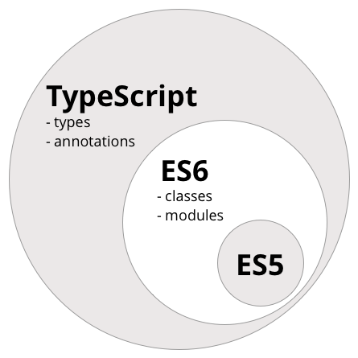
https://www.ng-book.com/2/p/TypeScript/

Slide 32
FRAMEWORKS

Slide 33



Slide 34
A Superheroic JavaScript MVW Framework
Google, ° Sept 2016 (AngularJS: Oct 2010)
An Intuitive, Fast and Composable MVVM for
building interactive interfaces
Evan You, ° Feb 2014
A JavaScript library for building user interfaces (V)
Facebook, ° Mar 2013

Slide 36
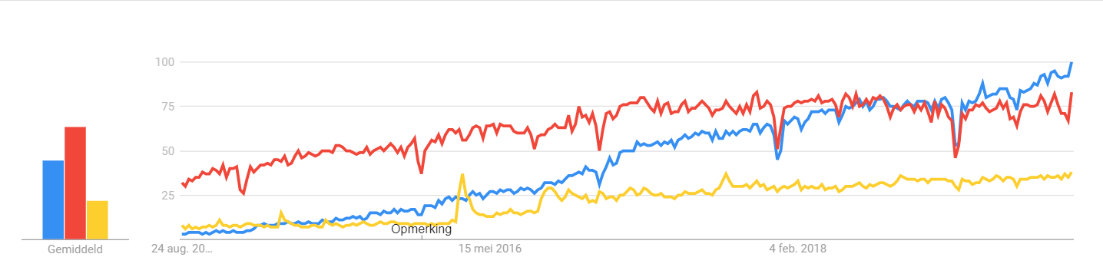
Google Trends

Slide 37
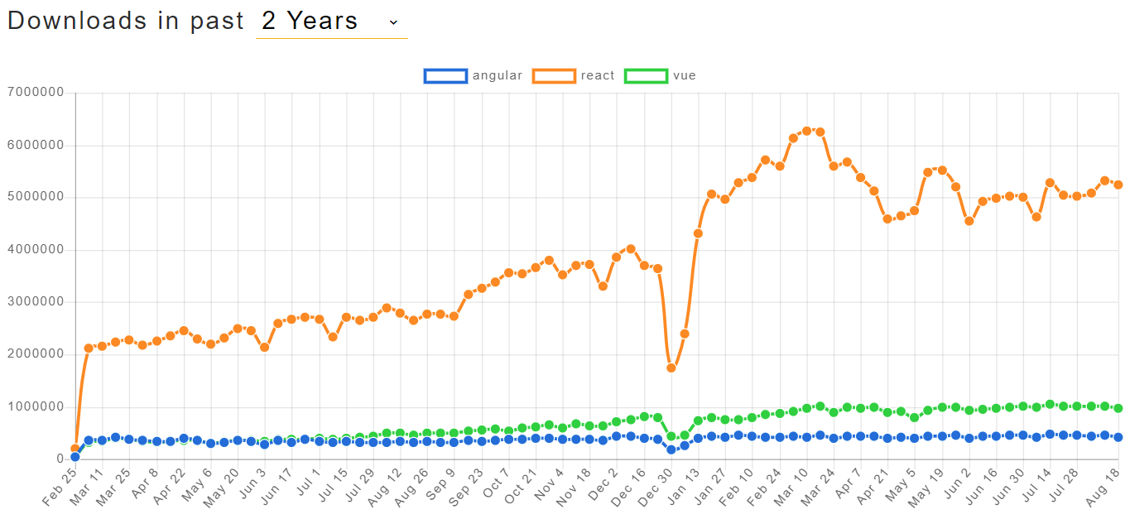
NPM Trends

Slide 38
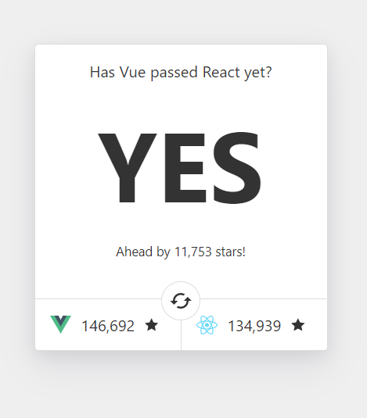
GitHub stars

Slide 39
Frameworks vs. libraries
Framework – strong opinions on how to structure application and a lot of
functionality out of the box
Complete solution, ready-to-go (if everything goes right)
Framework – “Vue.js does not make large assumptions about much of anything”
“Vue.js comes with the perfect balance of what it will do for you and what you
need to do yourself.”
Library – Universally flexible view oriented library (“UI as a function”)
With great flexibility comes great responsibility

Slide 40
COMPONENT DESIGN

Slide 41
Component Design
Component
Chunks of HTML and javascript that have a responsibility
Even the application is a component
Represented by a typescript class
Two-way data binding
Pass data through inputs
Child-components notify parent-components through outputs
Communication
Components only communicate with their direct parent, and always in the same direction
Notes:
Verschillende angular frameworks kort aanhalen. Verwijzen naar Angular IO als laatste nieuwe
https://angular.io/docs
‘npm update’ + ‘npm install’?

Slide 42
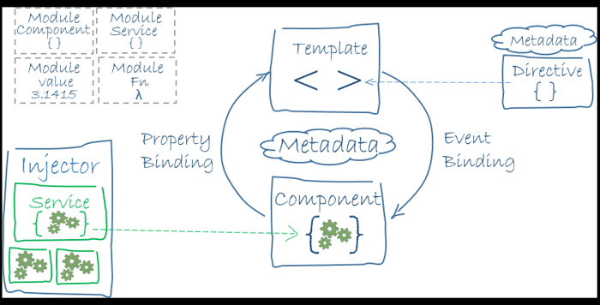
Component Design
Notes:
Verschillende angular frameworks kort aanhalen. Verwijzen naar Angular IO als laatste nieuwe
https://angular.io/docs
‘npm update’ + ‘npm install’?

Slide 43

Benefits of component design
Decrease complexity
Increase maintainability
Single responsibility (SoC)
Reusability
Testability

Slide 44
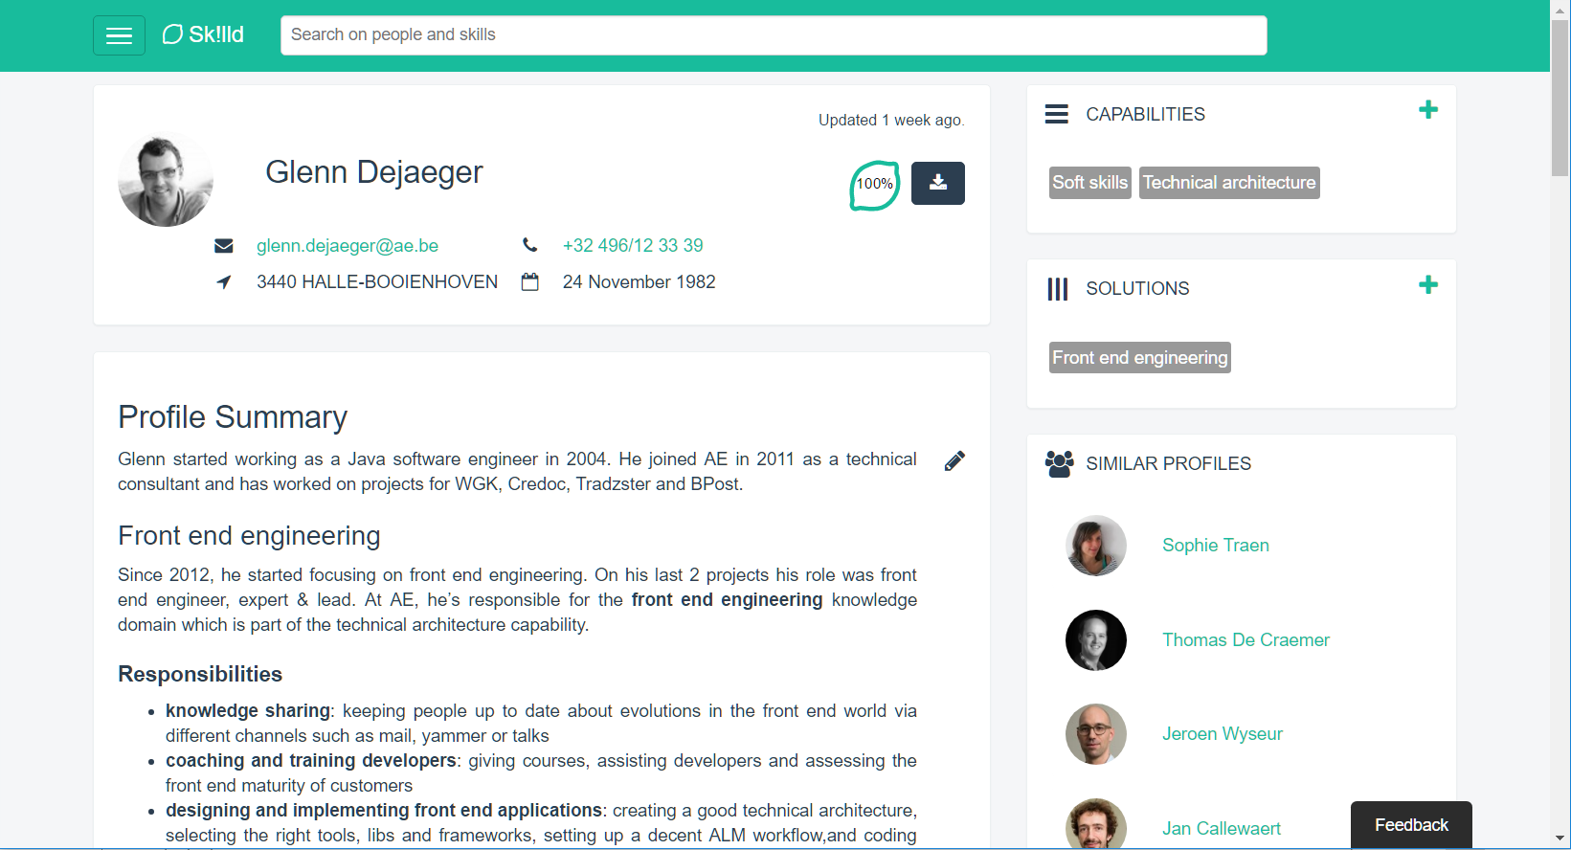

Slide 45
1
2
5
3
4

Slide 46
VUE.JS

Slide 47
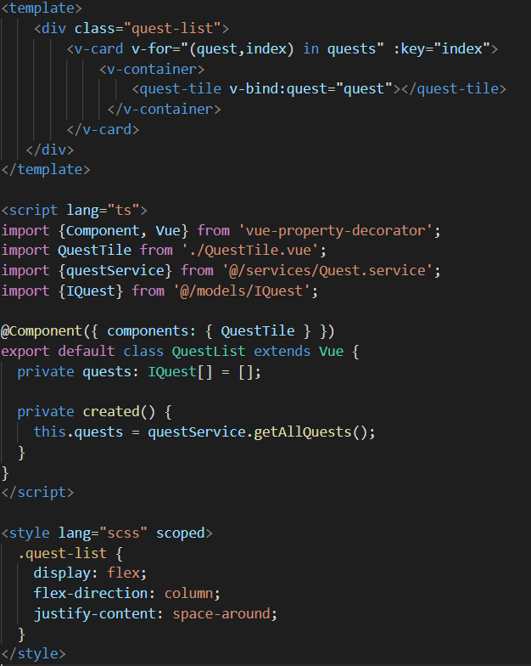
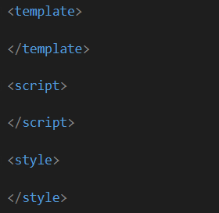

Slide 48
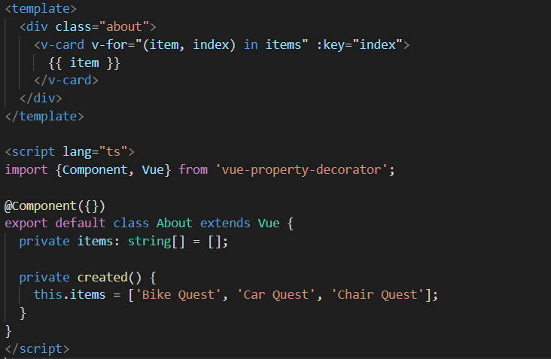

Slide 49
DEBUGGING

Slide 50
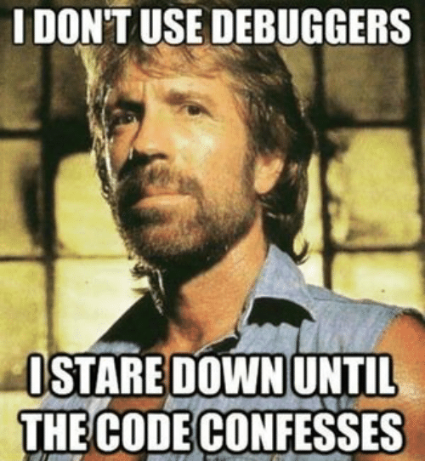

Slide 51
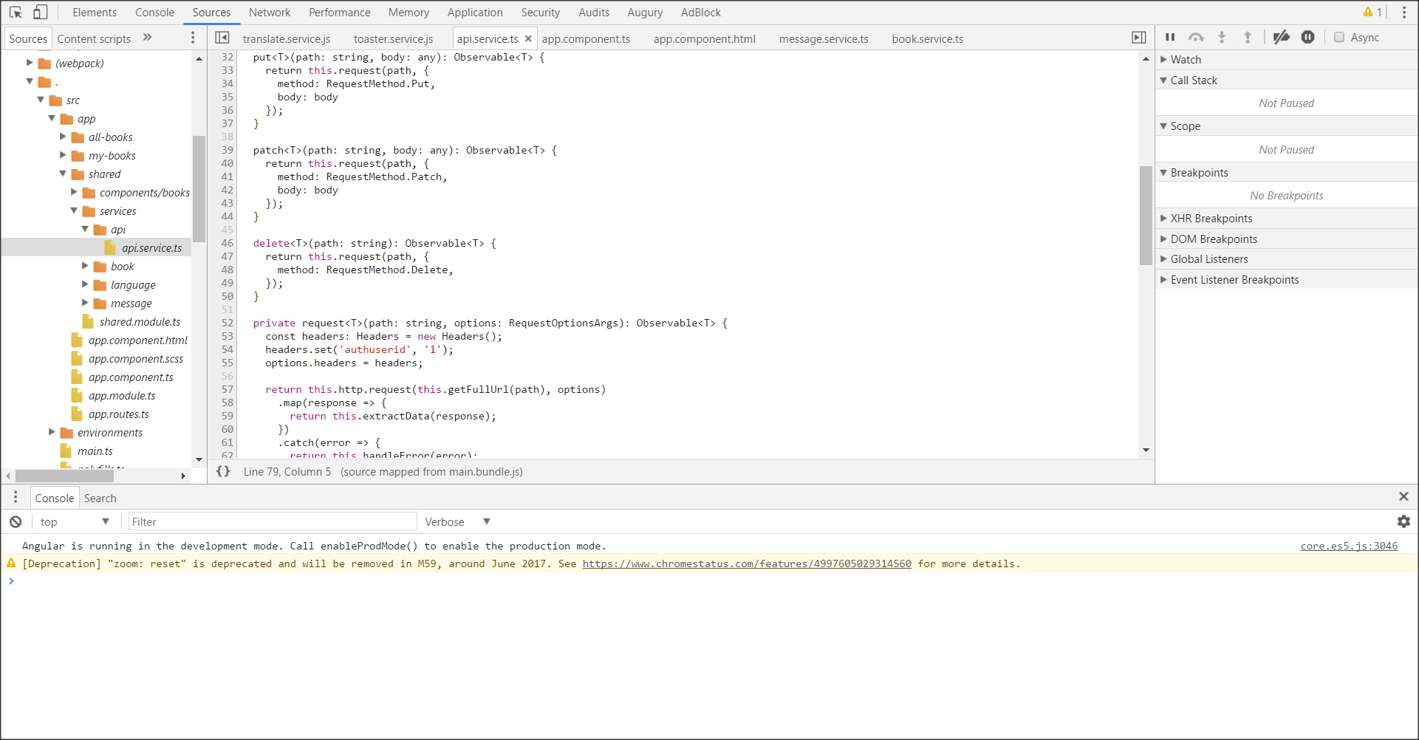
Chrome Dev Tools
https://developer.chrome.com/devtools

Slide 52
Vue dev tools

Slide 53
LET’S BUILD AN APP

Slide 54
Git
git clone <repo>
git fetch
git checkout <branch>
git add <change>
git commit –m “<message>”

Slide 55
npm install -g @vue/cli
git clone https://github.com/AE-nv/TA-Fundamentals-FEE-2019.git
cd TA-Fundamentals-FEE-2019
git checkout bike-quest/exercise-1
cd karma-village
npm i
npm run serve
Go to http://localhost:8080

Slide 56
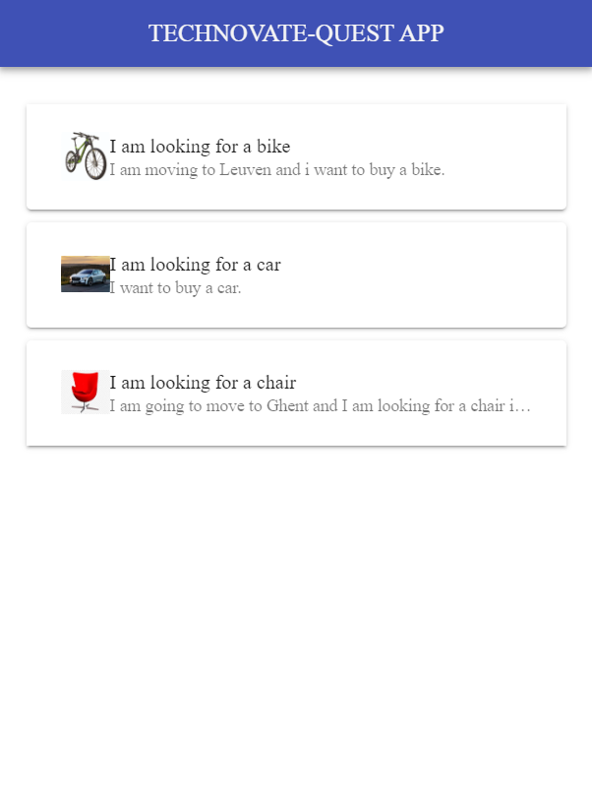
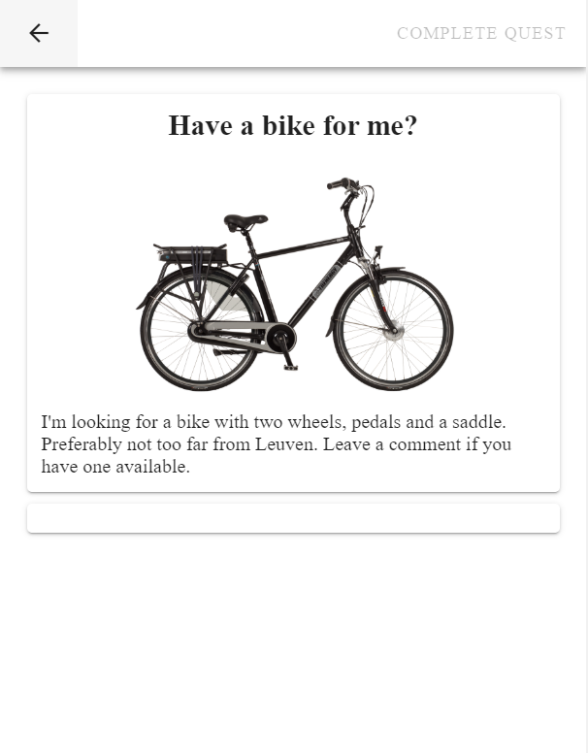

Slide 57
Bike Quest – Exercise 1
Add a v-textarea
Display input in v-card

Slide 58
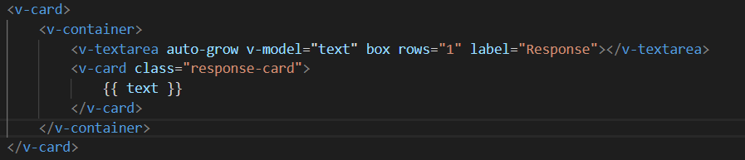
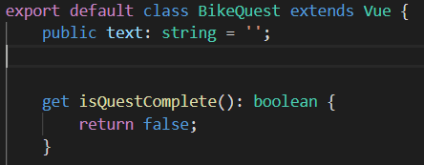
BikeQuest.vue

Slide 59
Bike Quest – Exercise 2
Add a v-btn
Add input to list when button is clicked
Display all responses in list

Slide 60
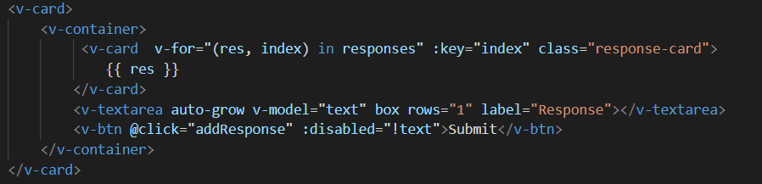
BikeQuest.vue

Slide 61
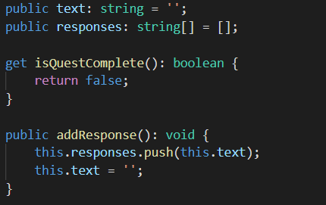
BikeQuest.vue

Slide 62
Bike Quest – Exercise 3
Complete quest when response contains words:
pedals
saddle
wheels

Slide 63
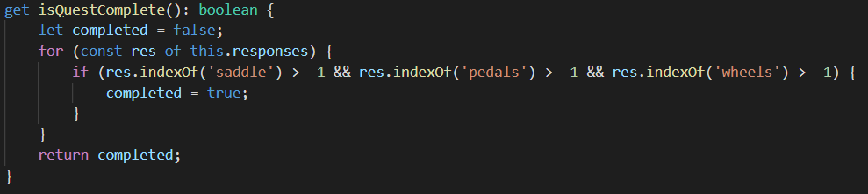
BikeQuest.vue

Slide 64
Bike Quest – Exercise 4
Move text-area to TextAreaBox.vue
Emit input to parent
Add text-area-box to BikeQuest.vue

Slide 65
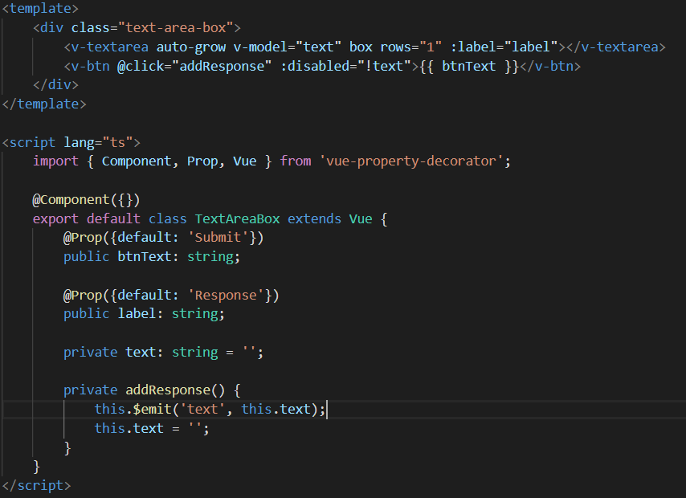
TextAreaBox.vue

Slide 66
TextAreaBox.vue

Slide 67
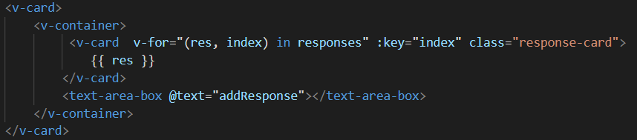
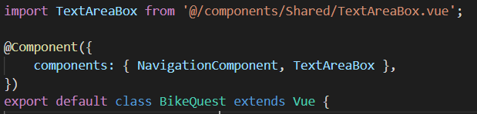
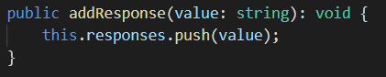
BikeQuest.vue

Slide 68
Car Quest – Exercise 1
Add text-box-area to CarQuest.vue
Call the CarSearchService when button is clicked
Display the result

Slide 69
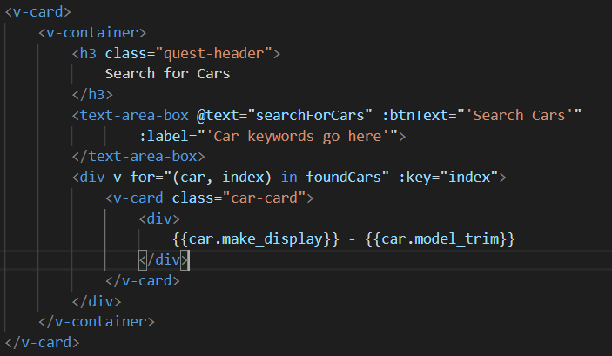
CarQuest.vue

Slide 70
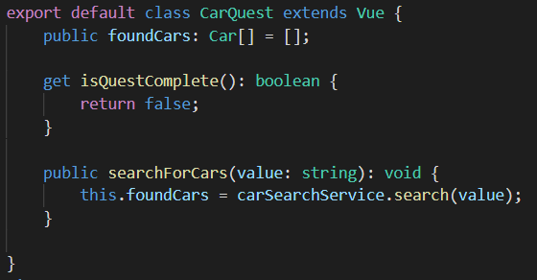
CarQuest.vue

Slide 71
Car Quest – Exercise 2
Implement the search function in the CarSearchService

Slide 72
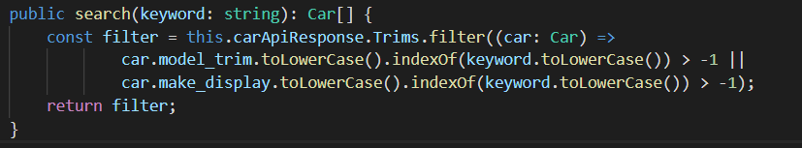
CarSearchService.vue

Slide 73
Car Quest – Exercise 3
Implement functions to recommend and unrecommend cars
Complete quest when recommended cars contains BMW

Slide 74
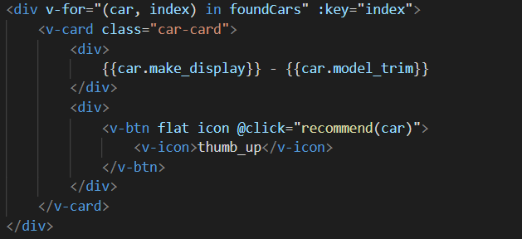
CarQuest.vue

Slide 75
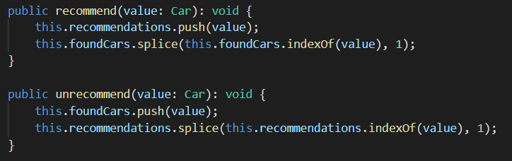
CarQuest.vue

Slide 76
Car Quest – Exercise 4
Replace recommended and result list by CarList component

Slide 77
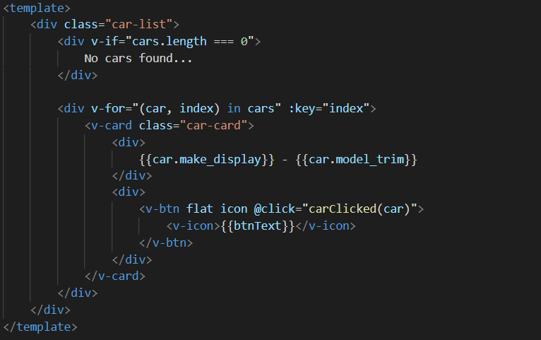
CarList.vue

Slide 78
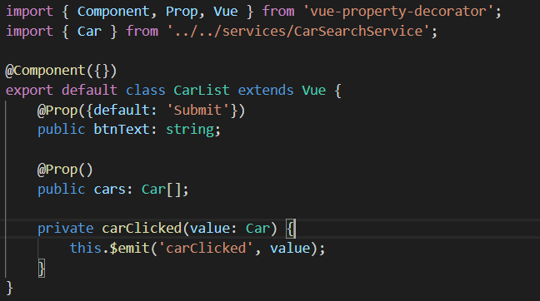
CarList.vue

Slide 79
Chair Quest – Exercise
Add a DropZone component
Show list of files that are uploaded
Call the GoogleVisionApi to determine characteristics
Provide user feedback about loading and result API-call

Slide 80
EXTRA EXTRA!

Slide 81
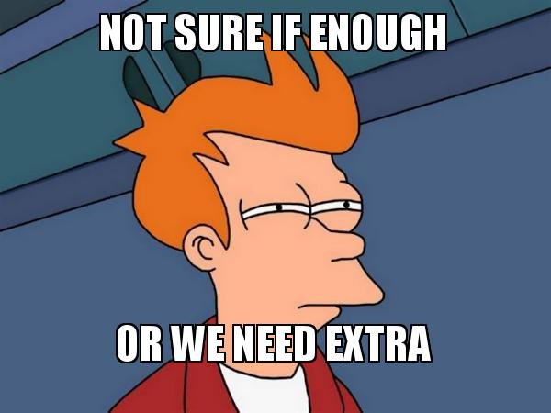

Slide 82
Interesting links
82

